Slide 1
Progress on DRDC projects
Yutong Zhao
Dec 17th 2018

Slide 2
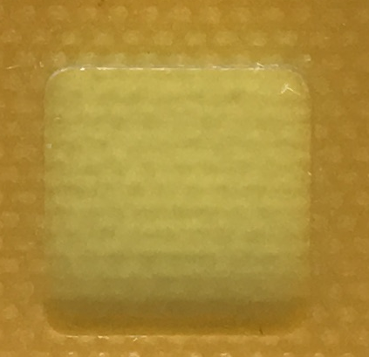
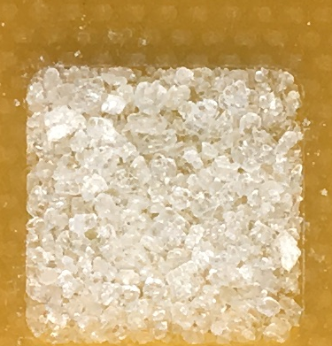
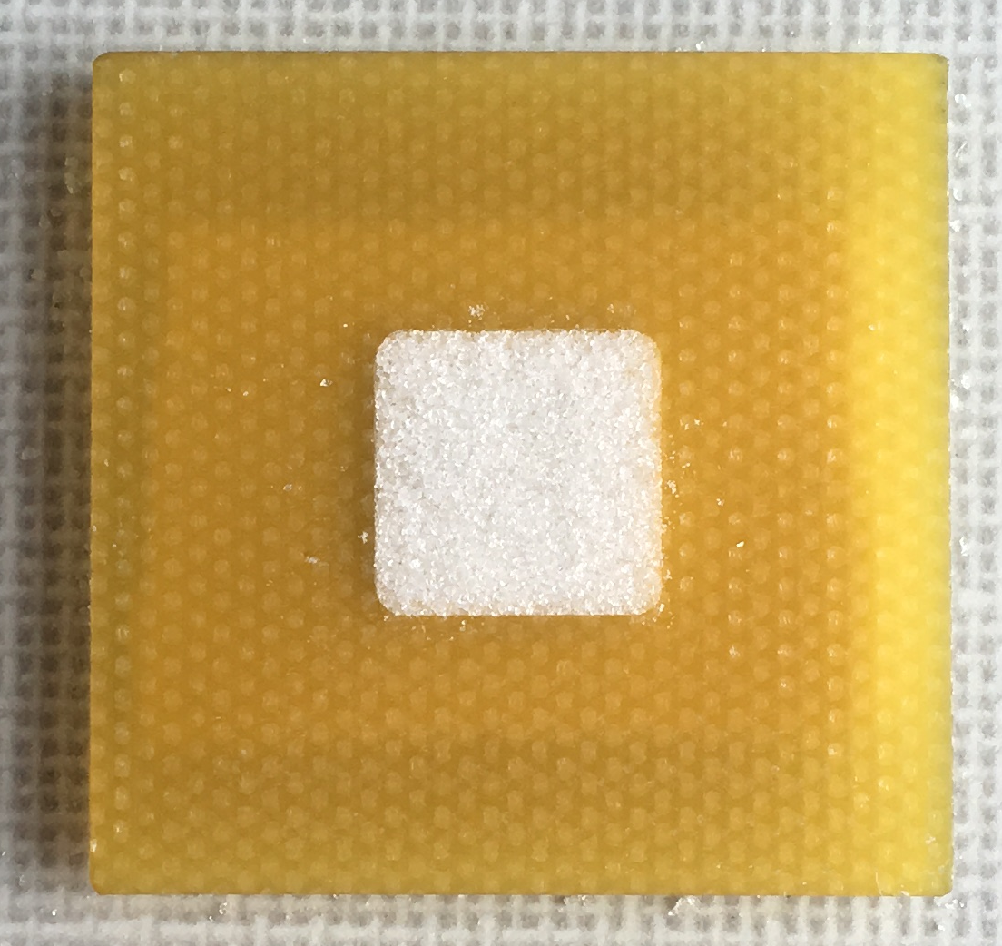
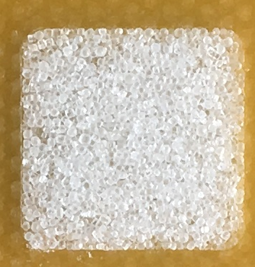
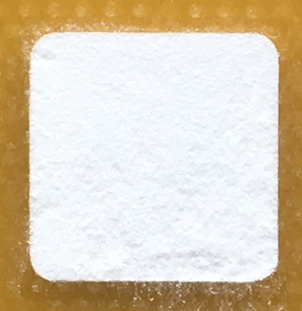
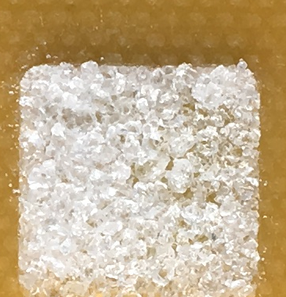
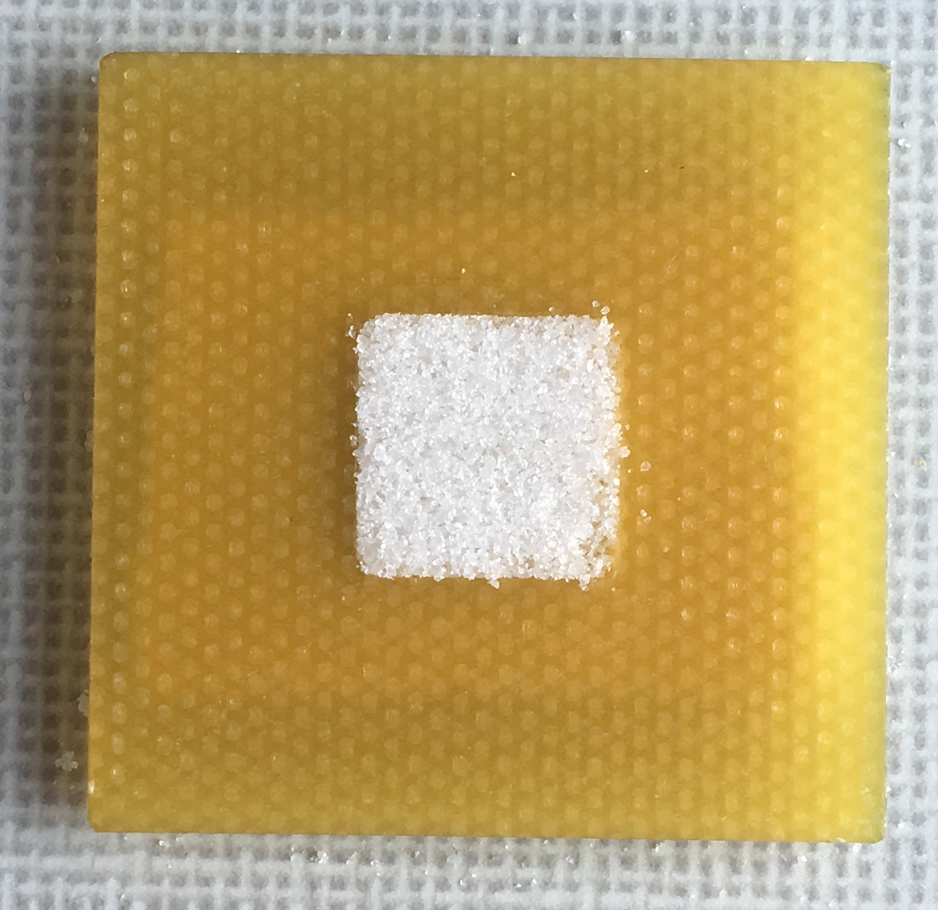
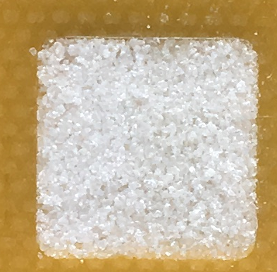
Optical image
Microwave image
Empty holder
KClO₃
KNO₃
NaCl
Empty holder
KClO₃
KNO₃
NaCl
NH₄NO₃& KNO₃
Mixture
NH₄NO₃& KNO₃
Mixture
Icing sugar
NaNO₃
NH₄NO₃
Icing sugar
NaNO₃
NH₄NO₃

Slide 3
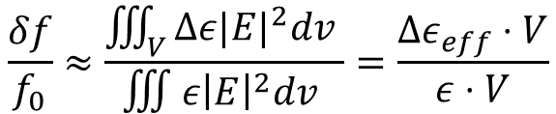
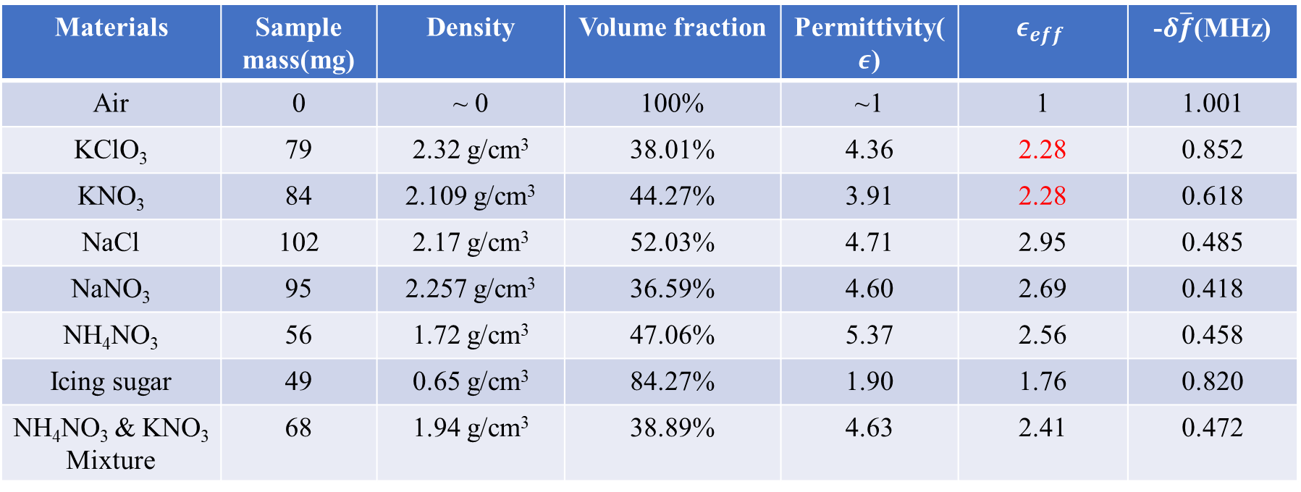
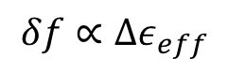
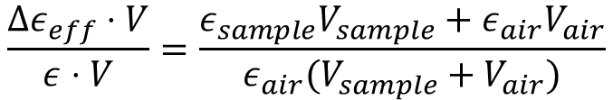
Using Cavity perturbation theory:
$$δf∝Δε_{eff}$$
$$\frac{δf}{f_{0}}≈\frac{\iiint_{V}{Δε|E|^{2}dv }}{∭ε{\left|E\right|}^{2}dv }=\frac{Δε_{eff}⋅V}{ε⋅V}$$
$$\frac{Δε_{eff}⋅V}{ε⋅V}=\frac{ε_{sample}V_{sample}+ε_{air}V_{air}}{ε_{air}(V_{sample}+V_{air})}$$
Materials | Sample mass(mg) | Density | Volume fraction | Permittivity($ε$) | $$ε_{eff}$$ | -$δ\overline{f}$(MHz)
Air | 0 | ~ 0 | 100% | ~1 | 1 | 1.001
KClO₃ | 79 | 2.32 g/cm³ | 38.01% | 4.36 | 2.28 | 0.852
KNO₃ | 84 | 2.109 g/cm³ | 44.27% | 3.91 | 2.28 | 0.618
NaCl | 102 | 2.17 g/cm³ | 52.03% | 4.71 | 2.95 | 0.485
NaNO₃ | 95 | 2.257 g/cm³ | 36.59% | 4.60 | 2.69 | 0.418
NH₄NO₃ | 56 | 1.72 g/cm³ | 47.06% | 5.37 | 2.56 | 0.458
Icing sugar | 49 | 0.65 g/cm³ | 84.27% | 1.90 | 1.76 | 0.820
NH₄NO₃ & KNO₃ Mixture | 68 | 1.94 g/cm³ | 38.89% | 4.63 | 2.41 | 0.472

Slide 4
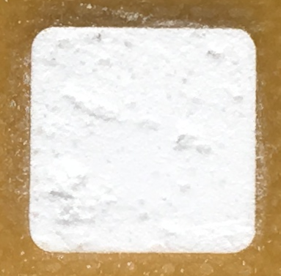
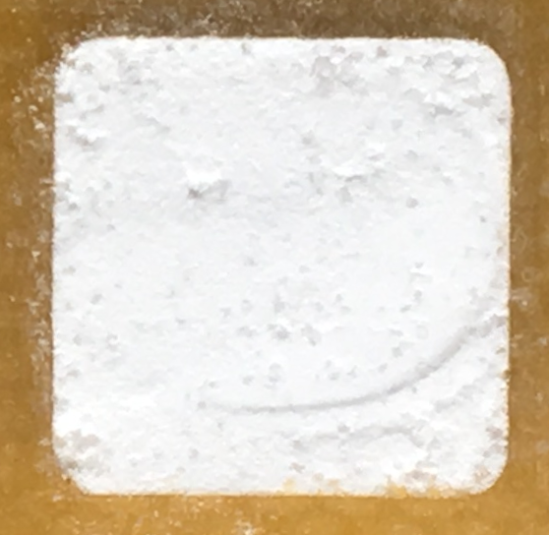
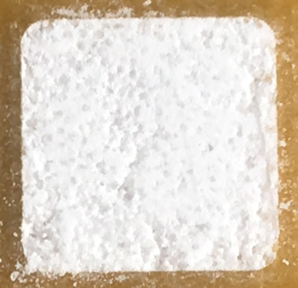
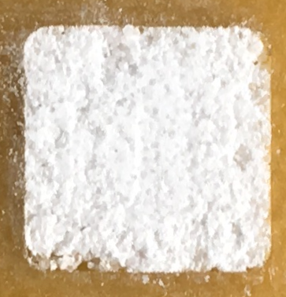
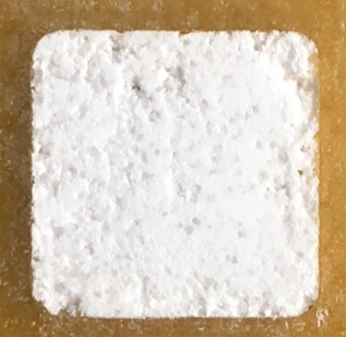
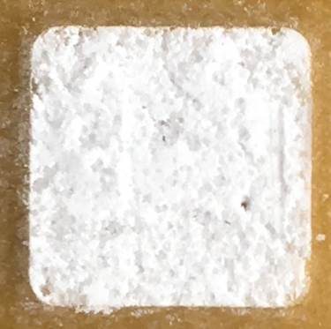
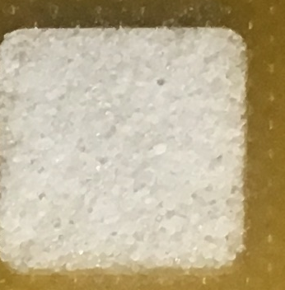
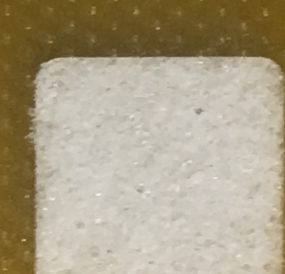
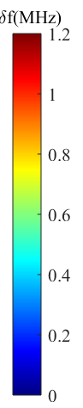
Mixture of icing sugar and NaCl
100%
90%
80%
70%
60%
In volume fraction
Optical image
50%
40%
30%
20%
0%
Microwave image

Slide 5
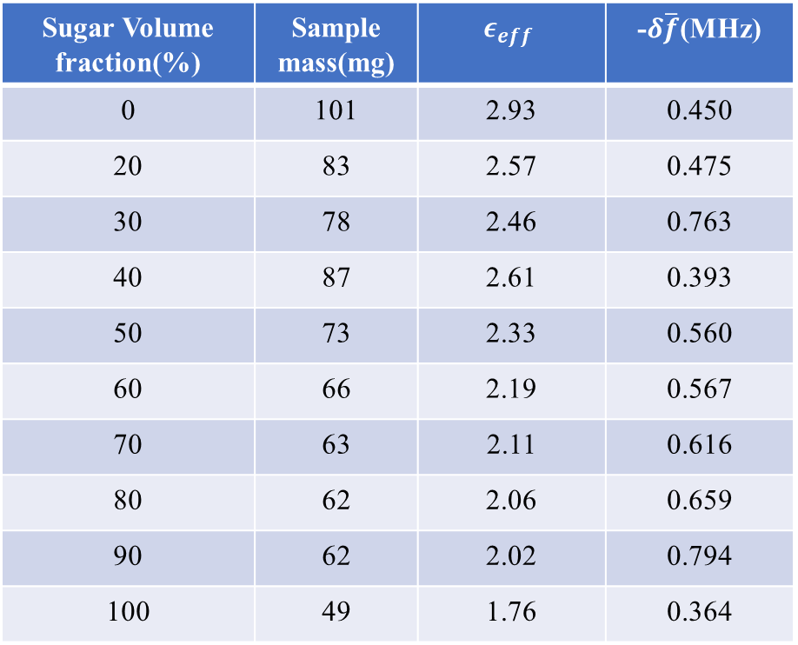
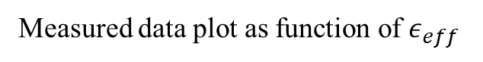
Mixture summary
Prediction of effective dielectric constant
Sugar Volume fraction(%) | Sample mass(mg) | $$ε_{eff}$$ | -$δ\overline{f}$(MHz)
0 | 101 | 2.93 | 0.450
20 | 83 | 2.57 | 0.475
30 | 78 | 2.46 | 0.763
40 | 87 | 2.61 | 0.393
50 | 73 | 2.33 | 0.560
60 | 66 | 2.19 | 0.567
70 | 63 | 2.11 | 0.616
80 | 62 | 2.06 | 0.659
90 | 62 | 2.02 | 0.794
100 | 49 | 1.76 | 0.364
Measured data plot as function of $ε_{eff}$

Slide 6
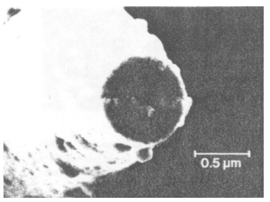
Summary:
The resonant shift of the is approximate a linear relation as effective permittivity.
It is unlikely to give the precise value due to large error bars.
The spatial distribution of chemical powders can be obtained using this method.
Next step:
Determine the dielectric constant of chemical solutions using broadband technique.
(non-resonant method).
Compare these results with different methods.
Sensor design:
Penetration depth: ↑
Resolution: ↓
Penetration depth: ↓
Resolution: ↑
Resolution: ~ nm
Only surface properties

Slide 7
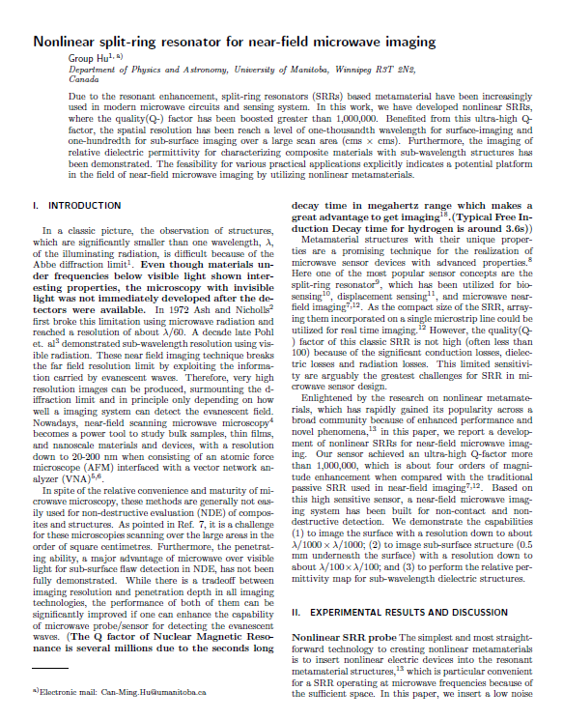
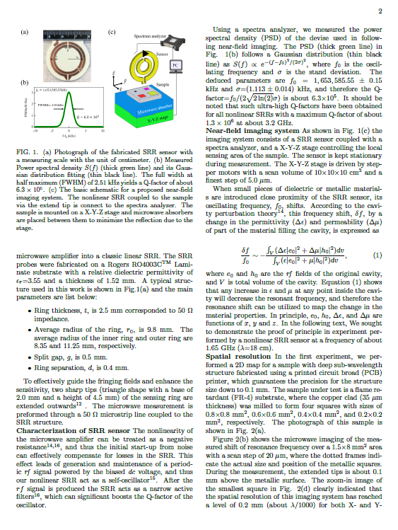
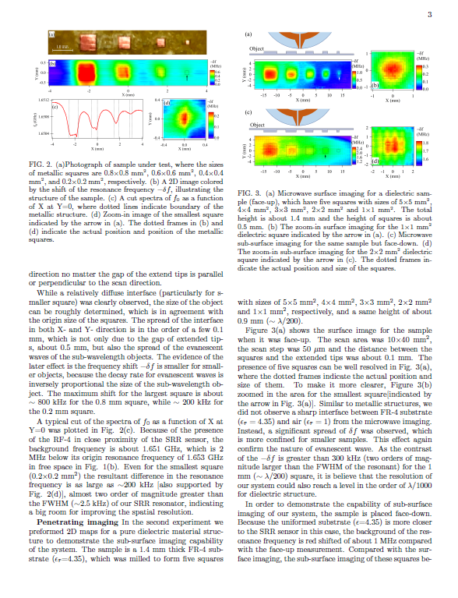
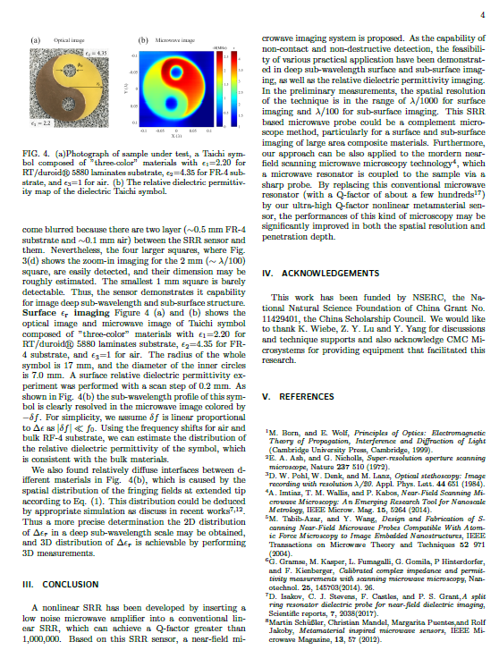
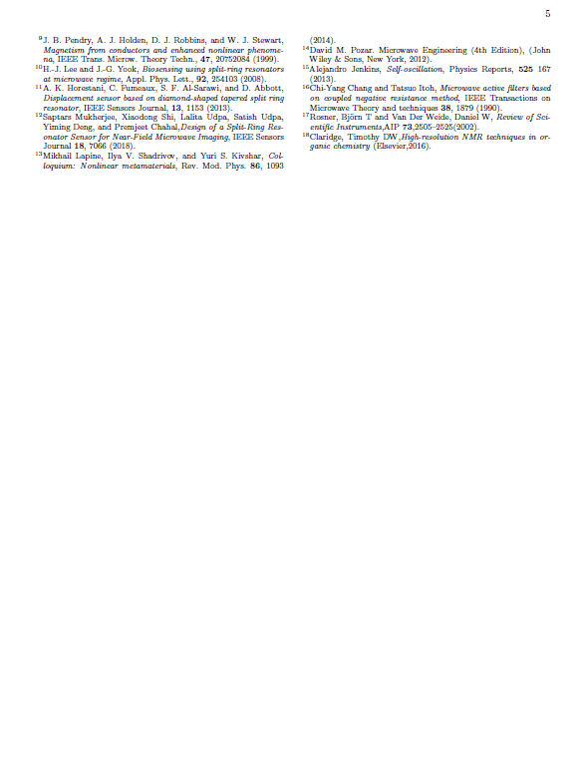
Finished first draft of the paper of dielectric imaging

Slide 8
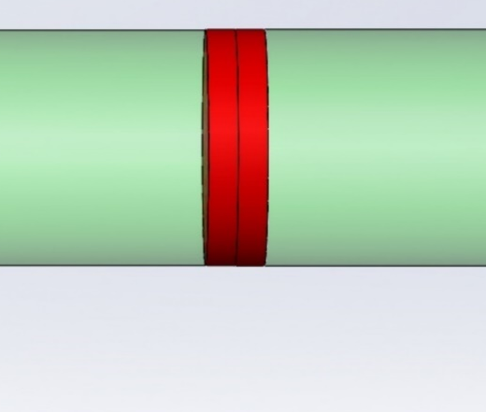
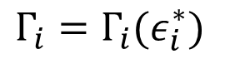
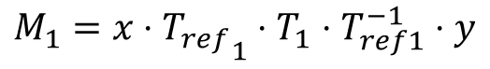
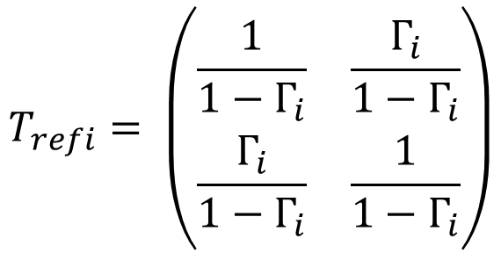
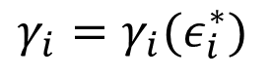
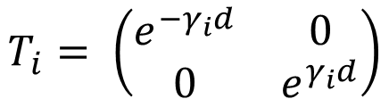
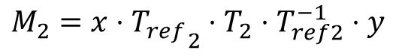
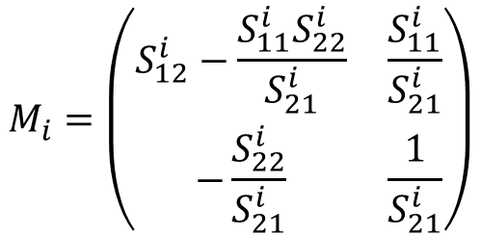
Broadband method
Air
Air
Tran
$$T_{i}= \left(\begin{matrix}e^{−γ_{i}d} & 0 \\ 0 & e^{γ_{i}d}\end{matrix}\right)$$
$$γ_{i}=γ_{i}(ε_{i}^{∗})$$
Air
$$M_{1}=x⋅{T_{ref}}_{1}⋅T_{1}⋅T_{ref1}^{−1}⋅y$$
$$M_{i}=\left(\begin{matrix}S_{12}^{i}−\frac{S_{11}^{i}S_{22}^{i}}{S_{21}^{i}} & \frac{S_{11}^{i}}{S_{21}^{i}} \\ −\frac{S_{22}^{i}}{S_{21}^{i}} & \frac{1}{S_{21}^{i}}\end{matrix}\right)$$
surface
I
Tran
Air
Air
Ref
$$T_{refi}= \left(\begin{matrix}\frac{1}{1−Γ_{i}} & \frac{Γ_{i}}{1−Γ_{i}} \\ \frac{Γ_{i}}{1−Γ_{i}} & \frac{1}{1−Γ_{i}}\end{matrix}\right)$$
Sample
$$Γ_{i}=Γ_{i}(ε_{i}^{∗})$$
$$M_{2}=x⋅{T_{ref}}_{2}⋅T_{2}⋅T_{ref2}^{−1}⋅y$$

Slide 9
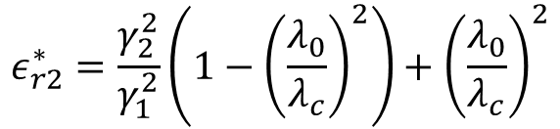
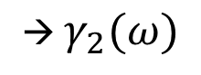
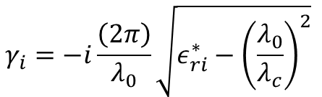

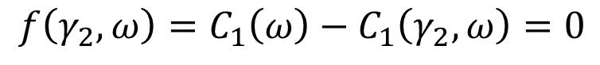
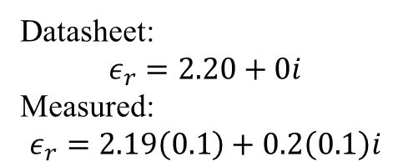
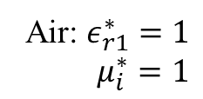
Propagation constant
$${{Tr(M}_{1}M}_{2}^{−1})=Tr{(T}_{ref1}T_{1}T_{ref1}^{−1}⋅T_{ref2}T_{2}^{−1}T_{ref2}^{−1})$$
$$γ_{i}=−i\frac{\left(2π\right)}{λ_{0}}\sqrt{ε_{ri}^{∗}−{\left(\frac{λ_{0}}{λ_{c}}\right)}^{2}}$$
Numerical equation:
$$f\left(γ_{2},ω\right)=C_{1}\left(ω\right)−C_{1}\left(γ_{2},ω\right)=0$$
→ $γ_{2}(ω)$
Multi-solutions.
Choose one that make sense
(good initial guess)
$$ε_{r2}^{∗}=\frac{γ_{2}^{2}}{γ_{1}^{2}}\left(1−{\left(\frac{λ_{0}}{λ_{c}}\right)}^{2}\right)+{\left(\frac{λ_{0}}{λ_{c}}\right)}^{2}$$
Dielectric constant:
Air: $ε_{r1}^{∗}=1$
$$μ_{i}^{∗}=1$$
RO5880 material:
Datasheet:
$$ε_{r}=2.20+0i$$
Measured:
$$ε_{r}=2.19\left(0.1\right)+0.2\left(0.1\right)i$$

Slide 10
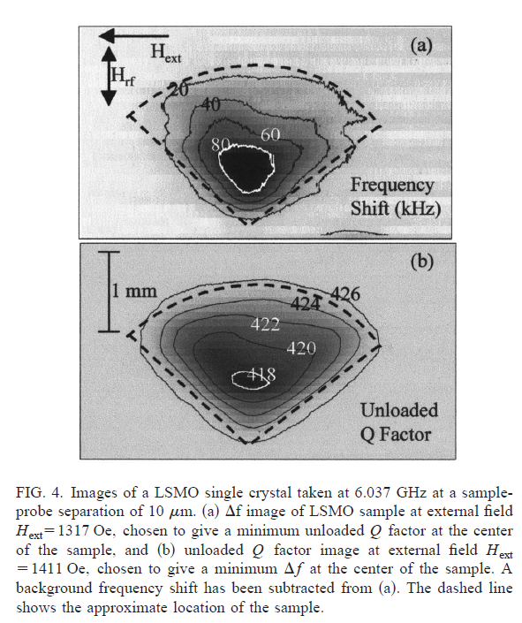
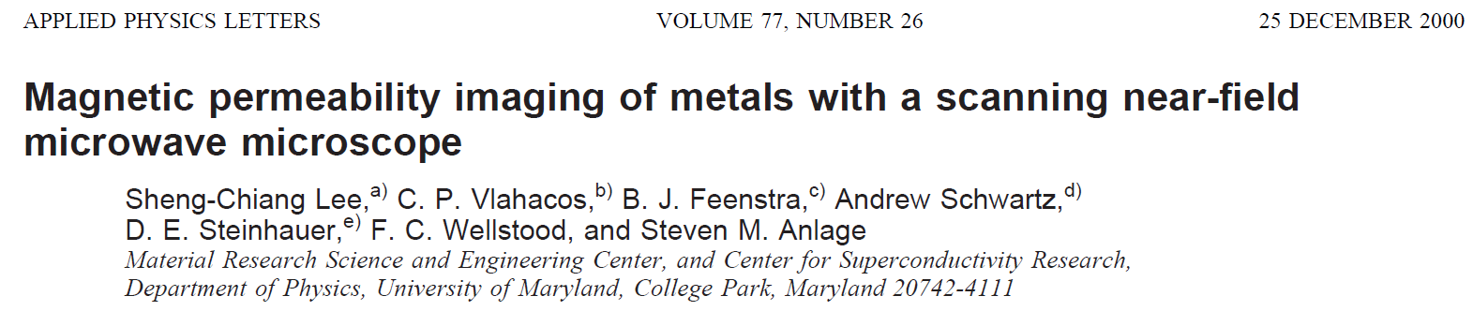
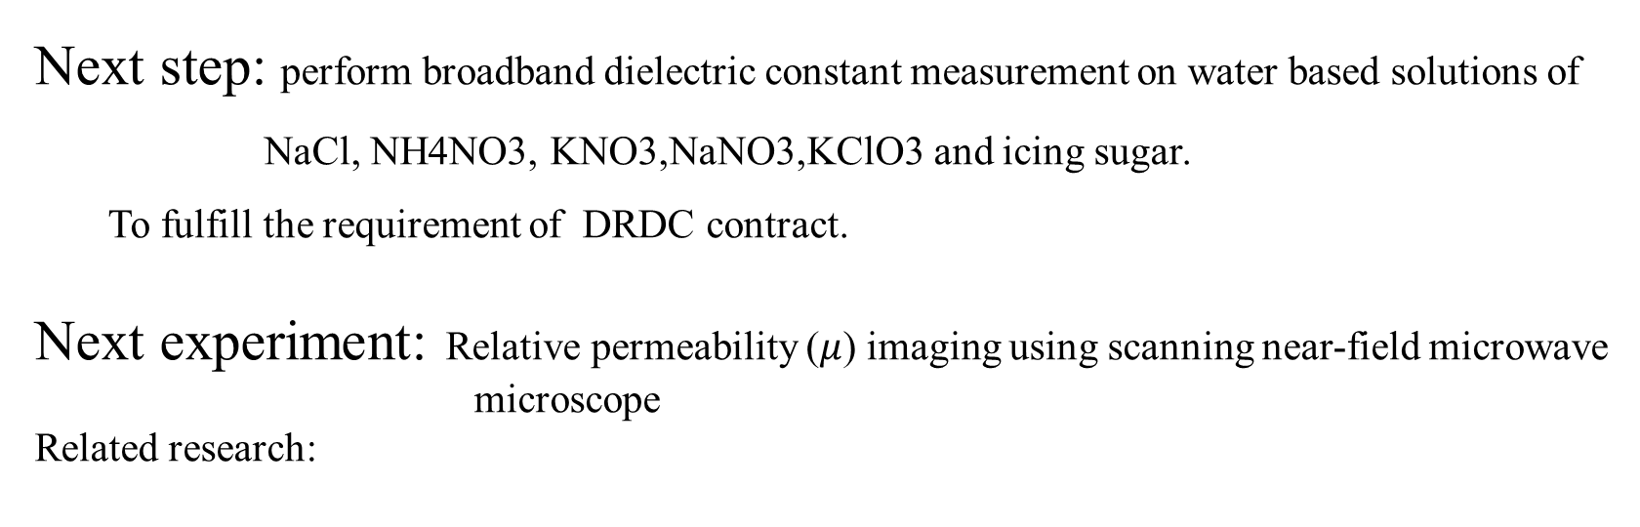
Next step: perform broadband dielectric constant measurement on water based solutions of
NaCl, NH4NO3, KNO3,NaNO3,KClO3 and icing sugar.
To fulfill the requirement of DRDC contract.
Next experiment: Relative permeability ($μ$) imaging using scanning near-field microwave
microscope
Related research:
Sample from Lanzhou University ➔ magnetic powder
Using a permanent magnet and microwave absorber to do the imaging.

Slide 11
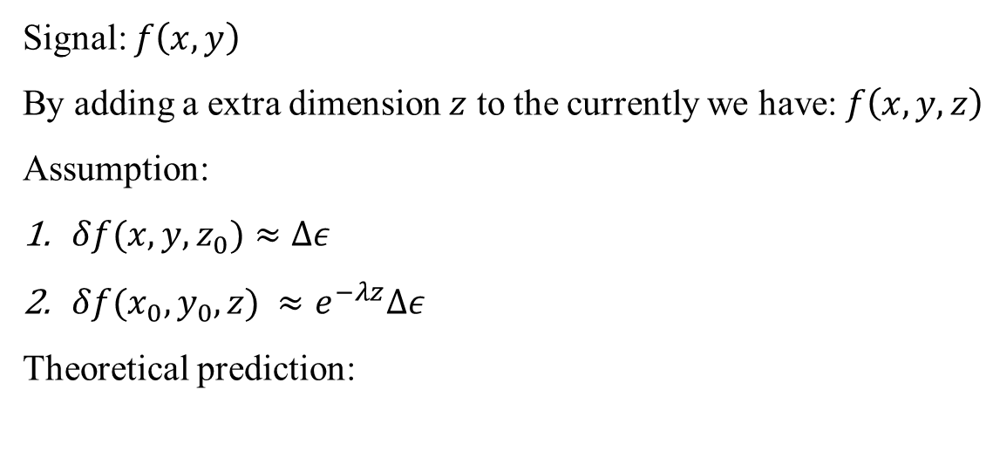
Signal: $f\left(x,y\right)$
By adding a extra dimension $z$ to the currently we have: $f\left(x,y,z\right)$
Assumption:
$δf(x,y,z_{0})≈Δε$
$δf(x_{0},y_{0},z) ≈e^{−λz}Δε$
Theoretical prediction:
Discussion:
The active SSR is able to detect dielectric constant of different materials.
As for chemicals, it is influenced by the size of the chemical granules and surface inhomogeneity.
It is very difficult to distinguish explosive chemicals and normal materials by using this method.
Plot in a.u.
Ok result/ large error
Good result/ small error
Surface
Surface

